Slide 1
Harvard FinTech Online short course
Problem 2:
BanQu and blockchain technology for shipping

Slide 2

Just a bite or all of it ?
BanQu
Unicredit

Slide 3
Unicredit ?

Slide 4

In a few words…
Network of 13 banks
Present in 4 regions
81 K people (employees)
1 leaner Corporate Center – Digital and Data
Pan-European Commercial Bank
2 product factories
15 M clients
+ $ 21 B, 2022

Slide 5




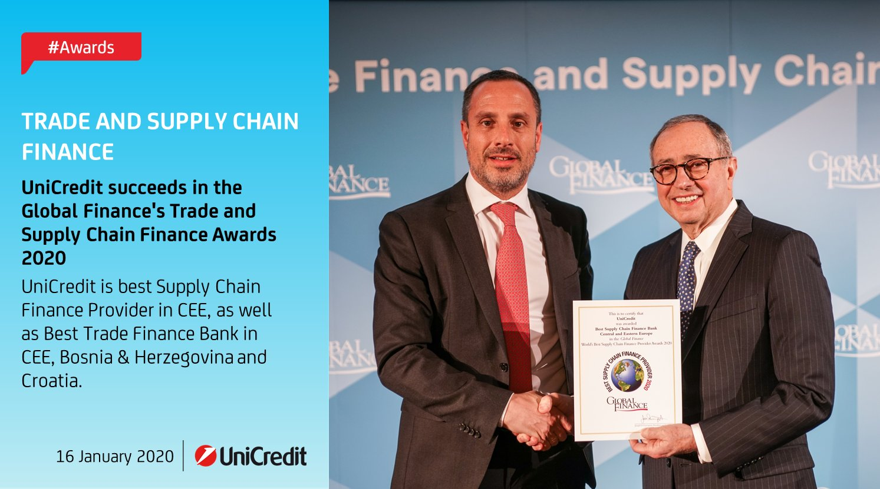

Esg and innovation…
1 SOCIAL Bond, $ 100 M
6 Green Bonds, $ 3.56 B
Best Bank Supply Chain Finance, COVID-19, 2020
GLOBAL, Supply Chain Finance, AWARDS, 2022
We.trade, 2017, 2019

Slide 6
BanQu ?

Slide 7

In brief…
Company
Inspired by dark “farm” in “farm to fork”
58 countries
13 languages
2.5 M people connected
Mission: Lift 100 M+ out of dire poverty by 2028
Platform
Real-time source data
Compliance via patented-blockchain
Sophisticated information tracking
Smart contracts
User-friendly and device agnostic

Slide 8

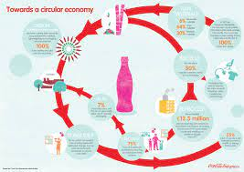

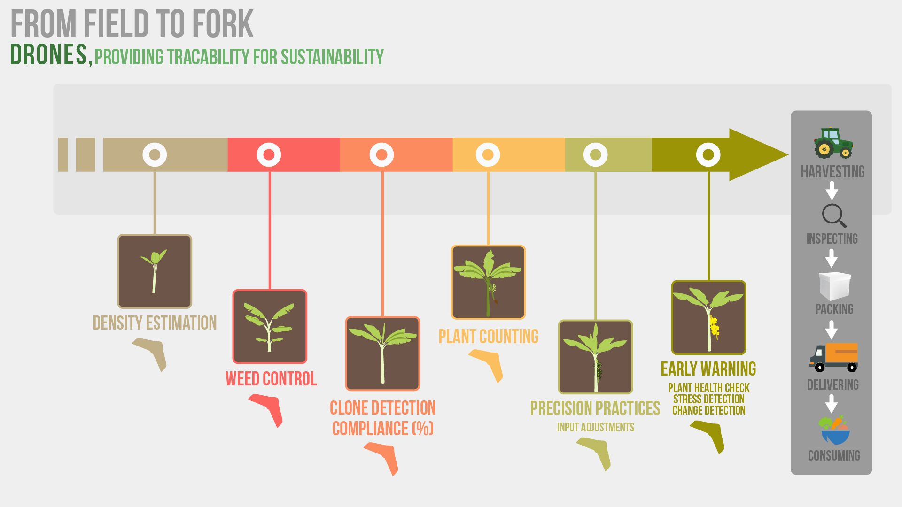
Track record …
track donor funding for COVID-19 relief
Coca-Cola: tracE recycled material across value chain
JTI (Japan Tobacco International: fight child labor
Zimbabwe Brewery: eliminate supply chain blindspots

Slide 9
So What ?

Slide 10




CONTEXT… champion among champions
Afore-mentioned achievements
Six accolades including “best bank” for transaction services
Fintech partnership – taulia, findynamic
OECD Due Diligence Guidance
EU Circular economy plan
European green deal
Net-zero industry act
Eu supply chain law

Slide 11



PROBLEM … winning on rugged terrain
BLOCKCHAIN
IBM
TRADELENS
WE.TRADE

Slide 12
HOW?

Slide 13


PROPOSED SOLUTION … lockstep between champions
Unicredit’s gain
Access to banqu’s info tracking and smart contract platform
Improved capacity to monitor supply chain, ensure compliance and initiate esg corrective measures
High Availability of source-data, real time reports, and raw material predictability
banqu’s gain
Access to unicredit’s extensive network:
13 banks
4 core European regions
15 million clients
Strategic partners and clients
Proposed Partnership model
Revenue sharing
Sustainable finance champion
Blockchain champion for supply chain

Slide 14
PERSPECTIVE … banqu upgrade
Banqu platform upgrade proposals
Verifying that company policies and management systems include appropriate due diligence
Assessing company’s commitment to reduction targets inscribed in paris climate agreement\
considering the entire supply chain as users and disposers of products, not only the direct suppliers
presenting to users of the platform possible civil liability for damages

Slide 15
Thank You

